Slide 1
Requirements Management
Module 5

Slide 2
Outline
Managing and Communicating System Requirements
Systems Engineering Tool
Requirements Allocation / Hierarchy
Verification and Validation

Slide 3
Managing and Communicating System Requirements

Slide 4
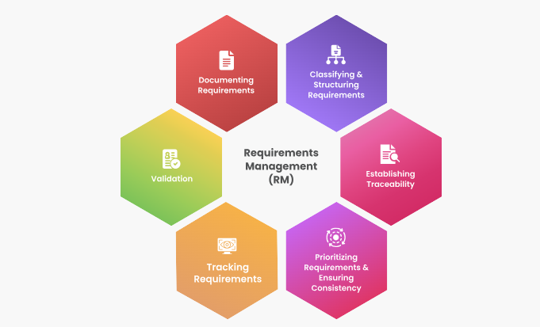
Requirements Management
It is a set of techniques for documenting, analysing, prioritizing, and agreeing on requirements so that engineering teams always have current and approved requirements.
Requirements management provides a way to avoid errors by keeping track of changes in requirements and fostering communication with stakeholders from the start of a project throughout the engineering lifecycle.

Slide 5
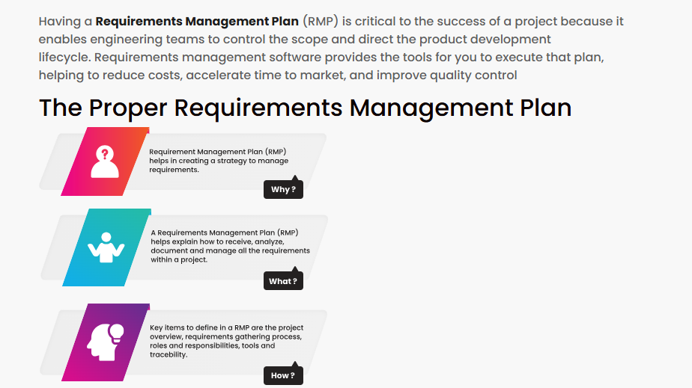
Requirements Management Plan

Slide 6
Requirements Communication
Requirements must be documented
Textual format
Operational scenarios, use cases, user stories
Diagrams / models
Tabular format
Requirements must be communicated across the system life cycle
Original/baseline; modified; added; deleted
Requirements Tools are useful in the managing and communicating requirements

Slide 7
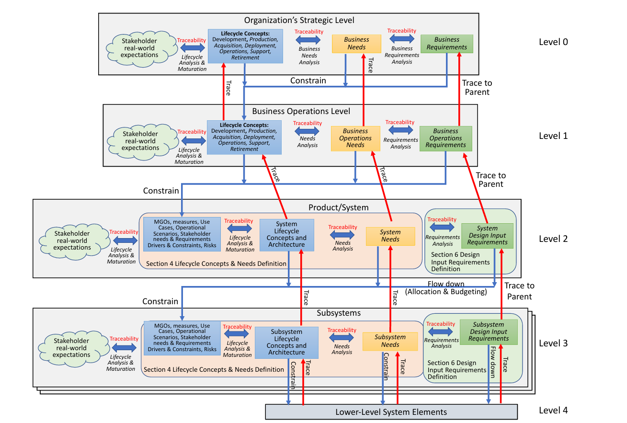
Flow down (allocation and budgeting) that occurs from one level of the system architecture to another.
Source : NeedsRequirementsmanual (INCOSE)

Slide 8
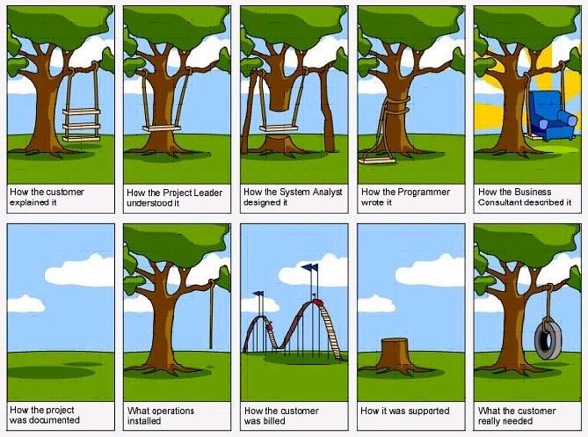

Slide 9
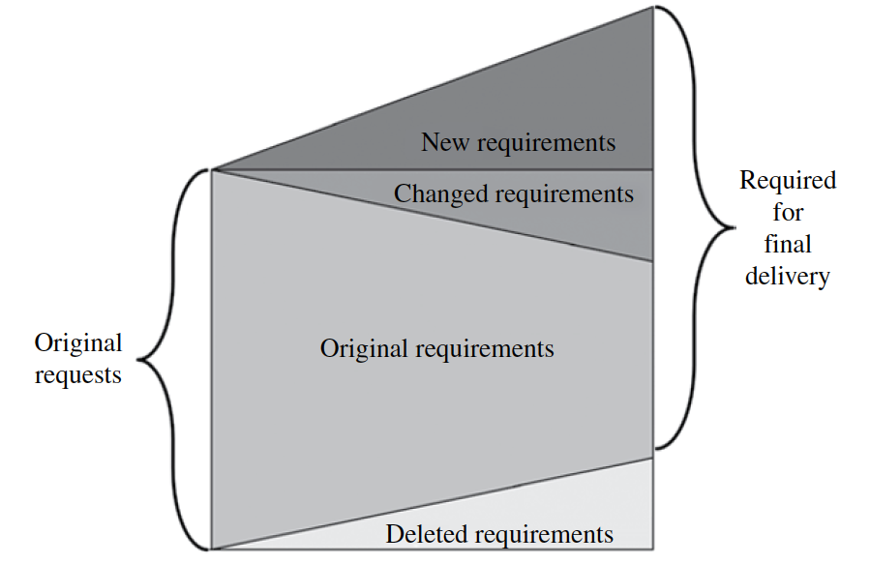
Requirements Over Time

Slide 10
Importance of System Requirements

Slide 11
Requirements Attributes
Attributes aid in the definition, verification, validation, management, and reuse of requirements
Organizations must define an attribute scheme that is specific to their domain, product line, and organization
While attributes are all potentially useful, too many should not be created because of the time and effort needed to define and maintain them.

Slide 12
Attributes for Requirements (1)
Attributes to help define needs and requirements and their intent.
A1 - Rationale
A2 - Trace to Parent
A3 - Trace to Source
A4 - States and Modes
A5 - Allocation / Budgeting

Slide 13
Attributes for Requirements (2)
Attributes associated with system verification or system validation.
A6 - System verification or system validation success criteria
A7 - System verification or system validation strategy
A8 - System verification or system validation method
A9 - System verification or system validation responsible organization
A10 - System verification or system validation level
A11 - System verification or system validation phase
A12 - Condition of Use
A13 - System verification or system validation results
A14 - System verification or system validation status

Slide 14
Attributes for Requirements (3)
Attributes to help manage the needs or requirements across the lifecycle.
A15 - Unique identifier
A16 - Unique name
A17 - Originator / Author
A18 - Date requirement entered
A19 - Owner
A20 - Stakeholders
A21 - Change Control Board
A22 - Change proposed
A23 - Version number
A24 - Approval date
A25 - Date of last change
A26 - Stability / Volatility
A27 - Responsible person
A28 - Need or requirement Verification status
A29 - Need or requirement Validation status
A30 - Status of the need or requirement
A31 - Status (of implementation)
A32 - Trace to Interface definition

Slide 15
Attributes for Requirements (4)
A33 - Trace to dependent peer requirements
A34 - Priority
A35 - Criticality or essentiality
A36 - Risk of implementation
A37 - Risk (mitigation)
A38 - Key driving need or requirement
A39 - Additional comments
A40 - Type / Category

Slide 16
Attributes for Requirements (5)
Attributes to show applicability and enable reuse
A41 - Applicability
A42 - Region
A43 - Country
A44 - State / Province
A45 - Market segment
A46 - Business unit
Attributes to aid in product line management
A47 - Product line
A48 - Product line common needs and requirements
A49 - Product line variant needs and requirements

Slide 17
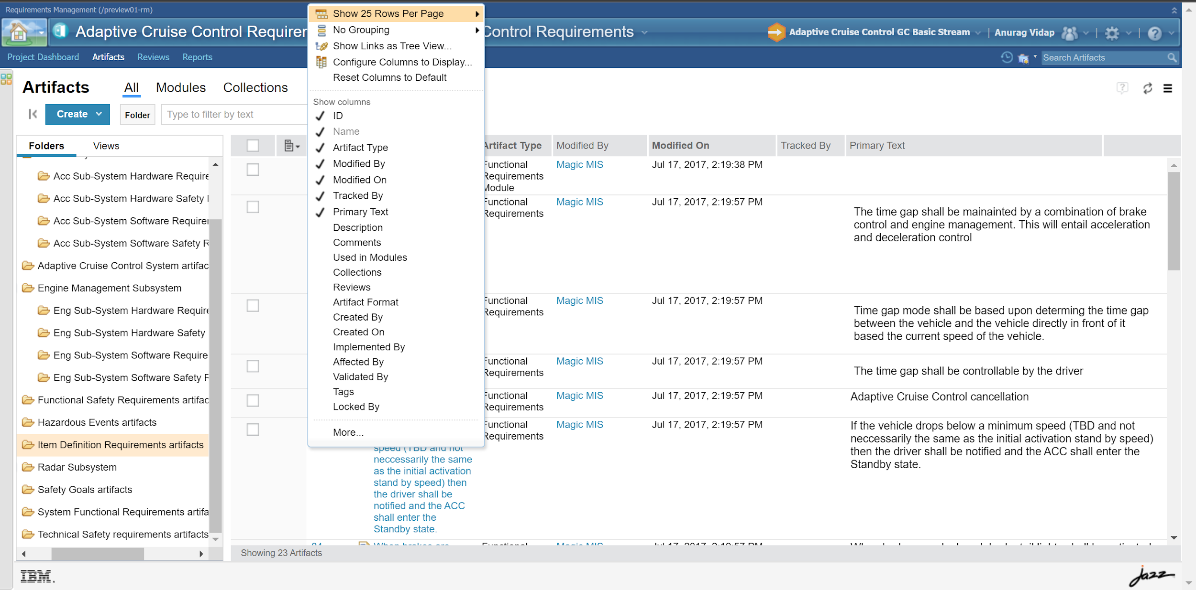
Attributes example from IBM Jazz

Slide 18
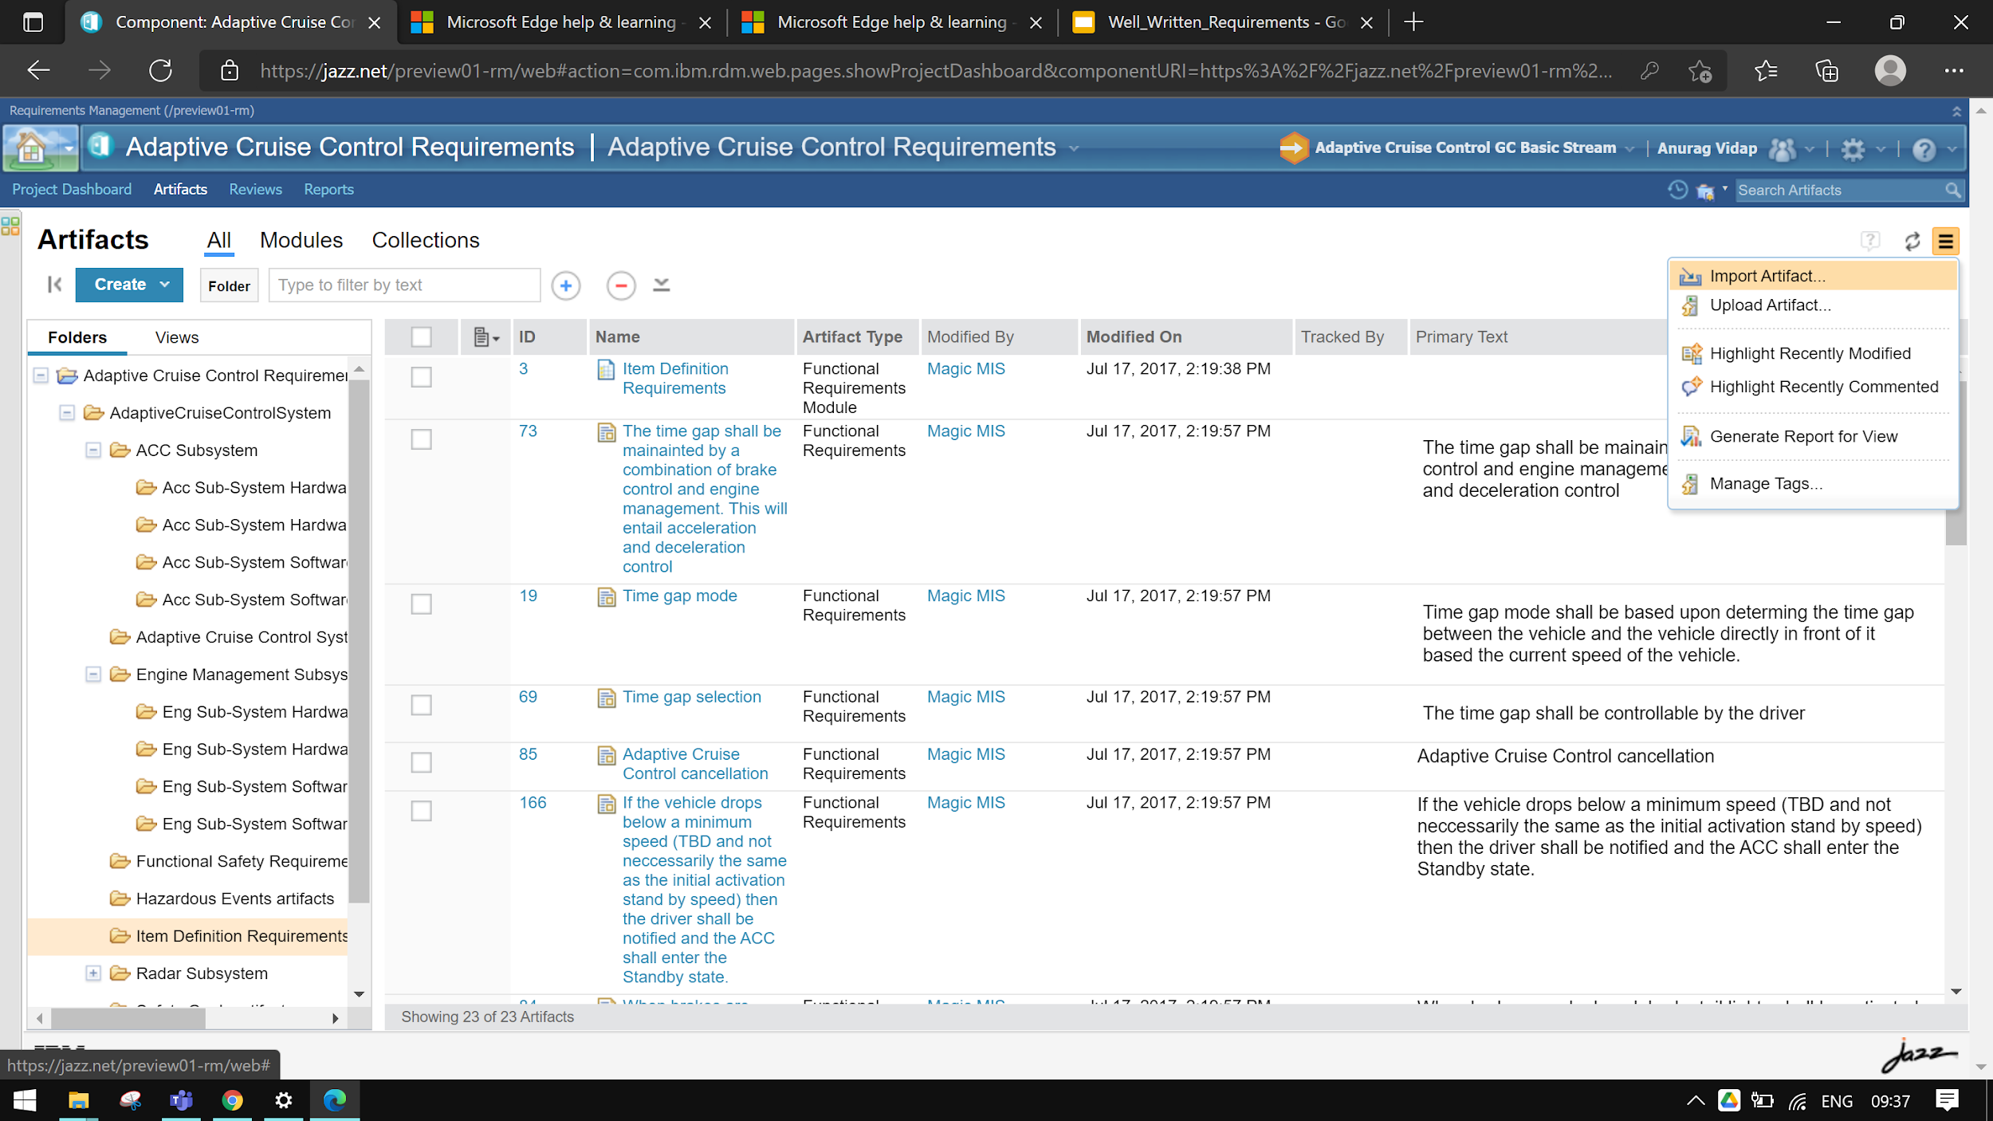
Requirements Example from IBM Jazz

Slide 19
Exercise 5.1
For your SOI,
Pick a few Software Requirements already identified, and discuss the following:
Define various attributes for SW Requirements
Fill out the attributes for those SW Requirements

Slide 20
Systems Engineering Tool

Slide 21
Desirable features of an SE tool (1)
Functionality
Needs and requirements quality
Grammatical structure of needs and requirements
Allocation, budgeting, and traceability
Interface management
Dependencies between artifacts and work products and their underlying data and information
Impact assessment
Ontology
Schema
Embedded Objects
Diagrams and drawings
Modeling
Reusability

Slide 22
Desirable features of an SE tool (2)
Tool attributes
Tailorable
Configuration / Customization
Learnability / Usability
Security
Accessibility (devices / location)
Online version Offline modes
Concurrent access
Performance
Collaboration
Tool integration - needs and requirements
Interoperability/tool integration - data sharing
Sharing of Data - external
Storage location
Scalability / extendibility
Archive/Backup/Long term availability

Slide 23
Desirable features of an SE tool (3)
Management and Reporting
Attributes
Measures
Reports
Metrics/dashboards
Notifications
Project management work products
Lifecycle support
Workflow
CM

Slide 24
Desirable features of an SE tool (4)
General Considerations
Price
Cost of infrastructure to support the use of the SE toolset
Vendor/product maturity
User feedback and satisfaction

Slide 25
Traceability
Every requirement must be traced back to a source
Traceability is bi-directional
Significantly enabled by SE Tool
Establishing traceability cannot be automated
Horizontal Traceability: across the lifecycle, and between peers
Vertical Traceability: between levels
Essential for performing impact analysis resulting from requirements change/modification, insertion, or deletion

Slide 26
Requirements Allocation / Hierarchy

Slide 27
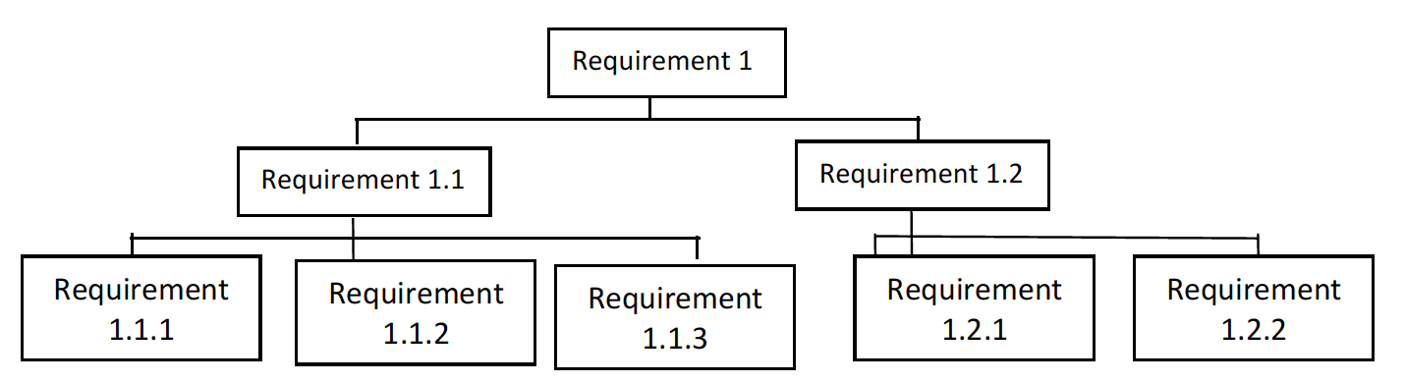
Requirements Hierarchy
Source: ”Systems Engineering Practices”, Ian Faulconbridge
Notes:
Basis for the Hierarchy?
Architecture
Org Structure

Slide 28
Requirements Traceability

Slide 29
Stakeholder & System Requirements
Elicitation of stakeholder requirements starts in Concept Definition
System requirements will be considered in detail during System Definition.
Stakeholder Requirements and System Requirements cannot be considered complete until consistency between the two has been achieved, as demonstrated by traceability, for which a number of iterations may be needed.

Slide 30
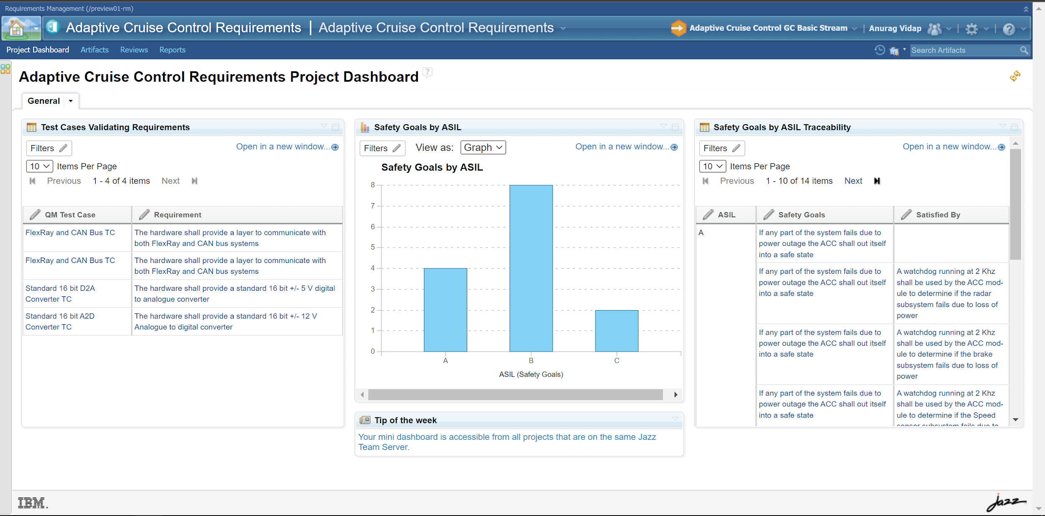
Traceability Example

Slide 31
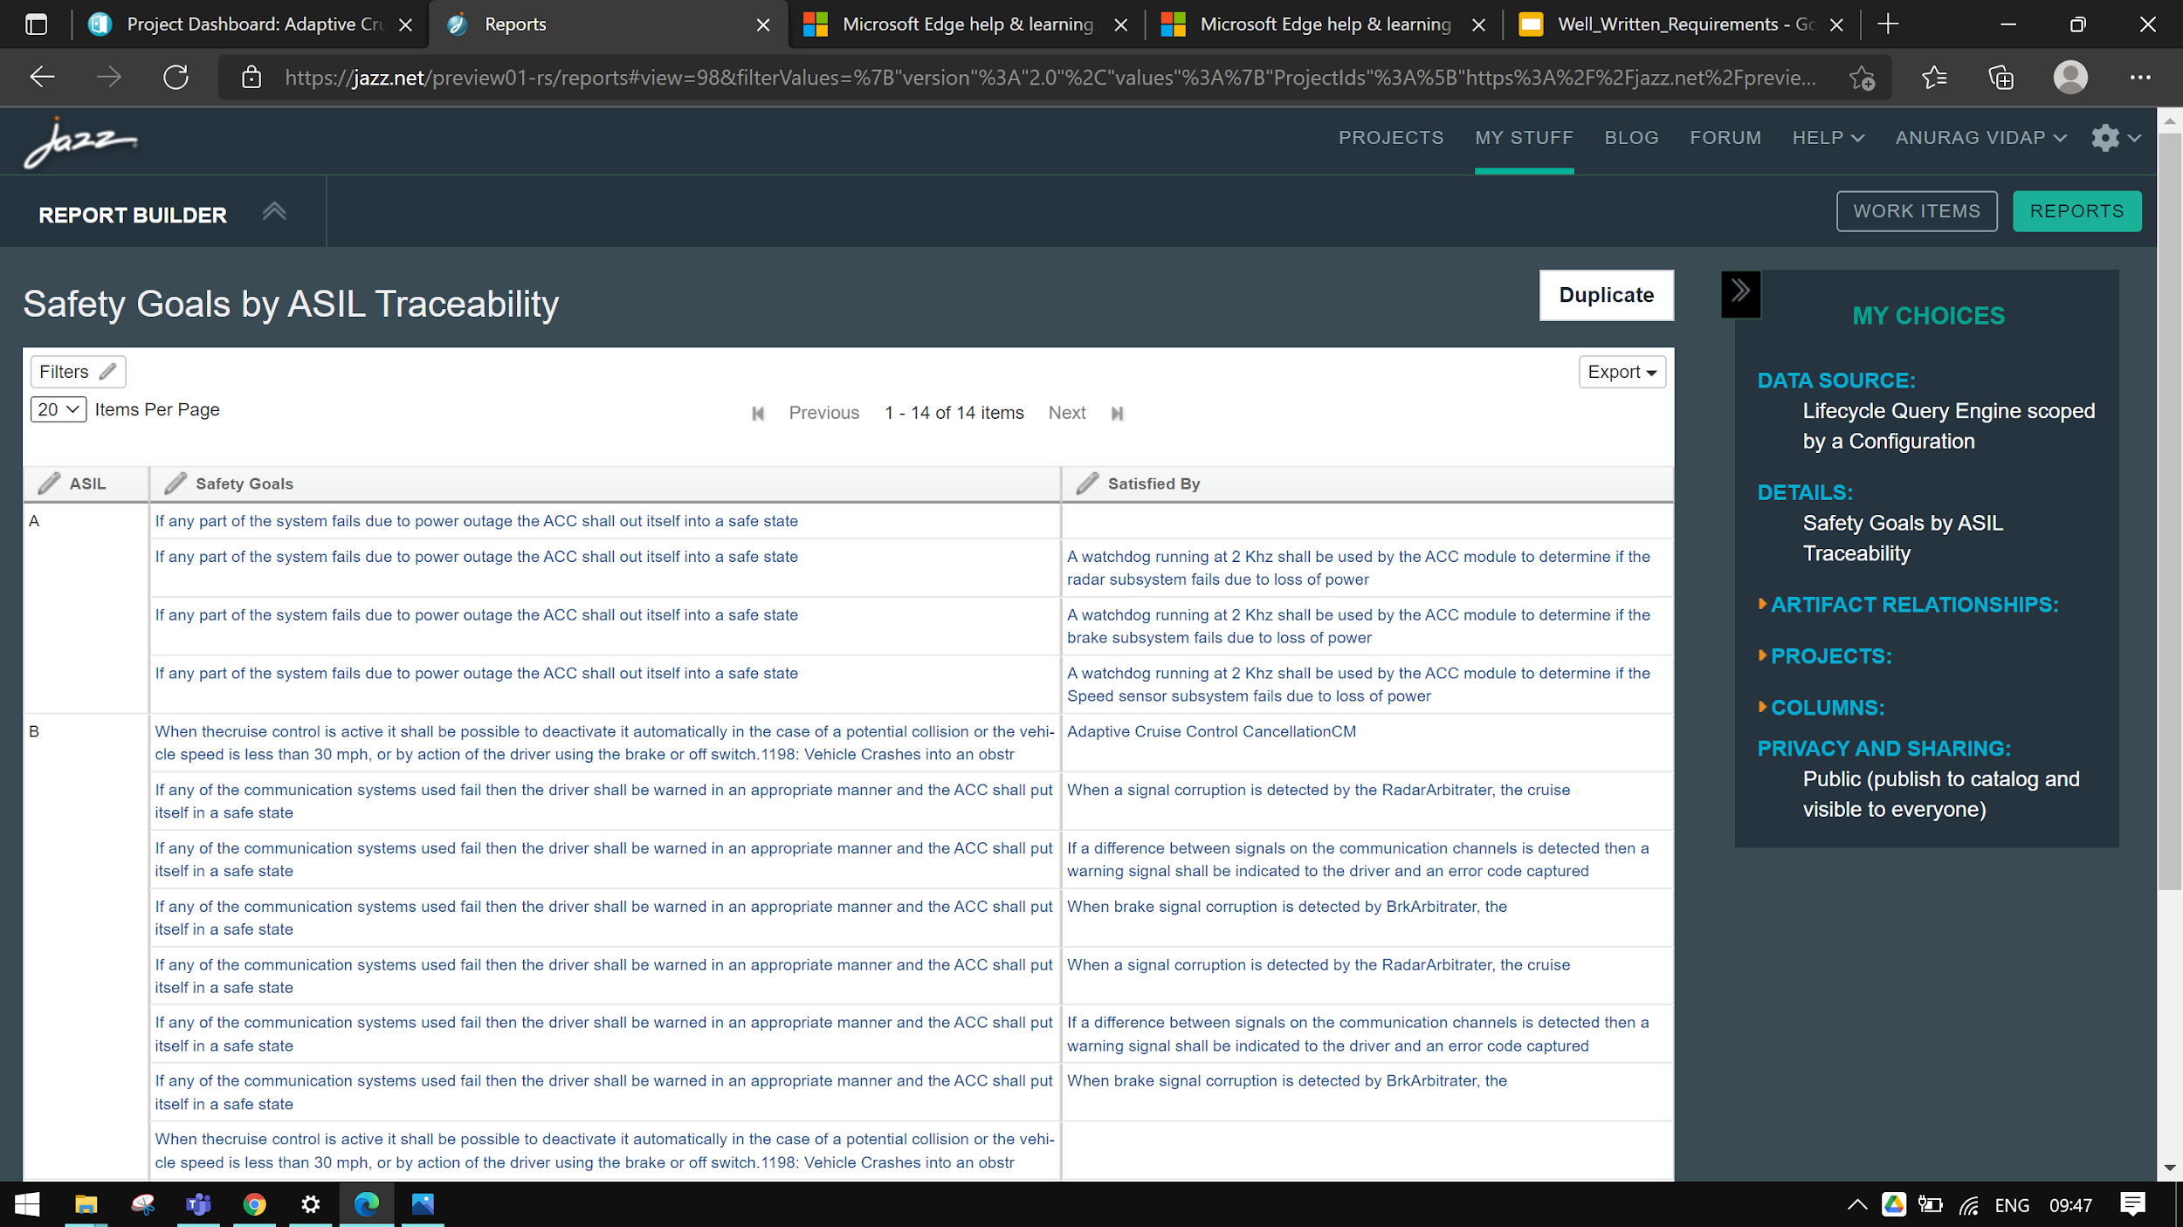
Traceability Example

Slide 32
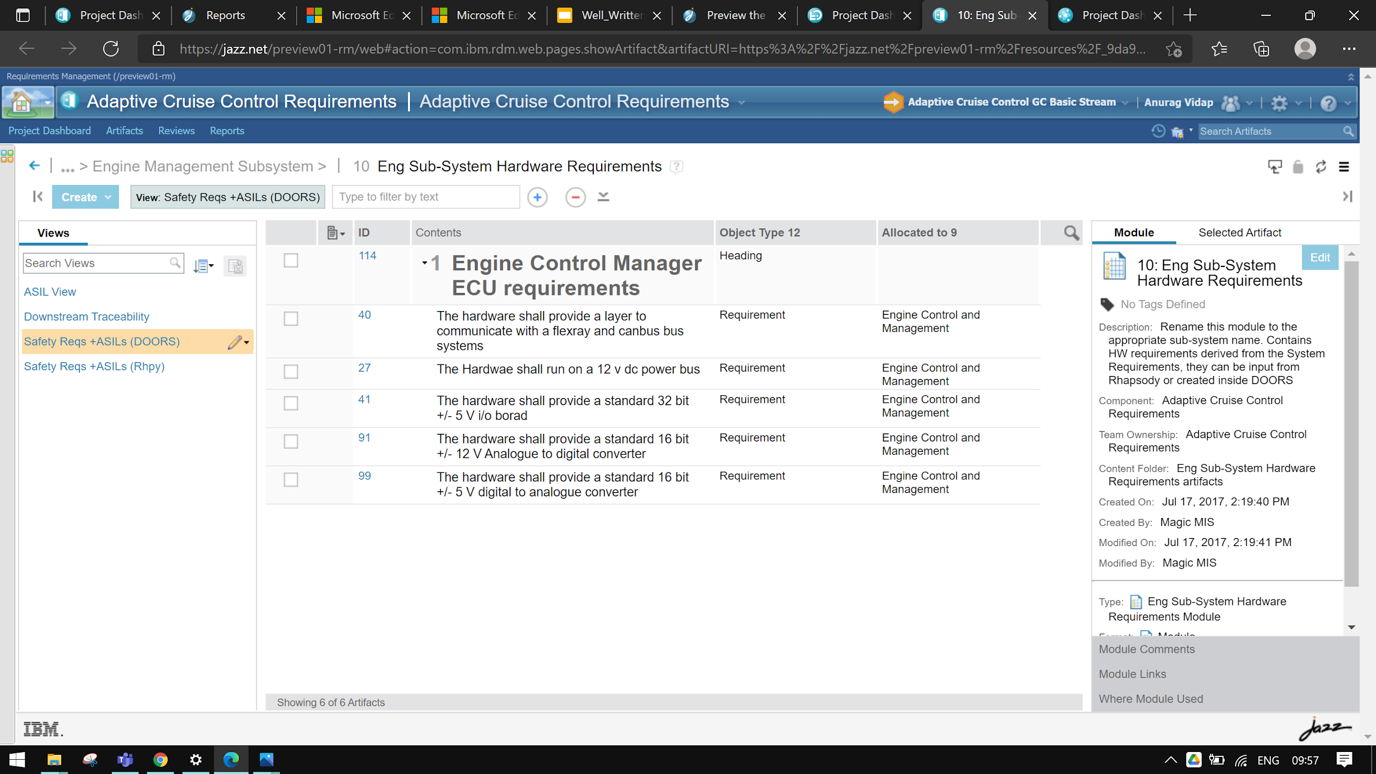
Allocation Example

Slide 33
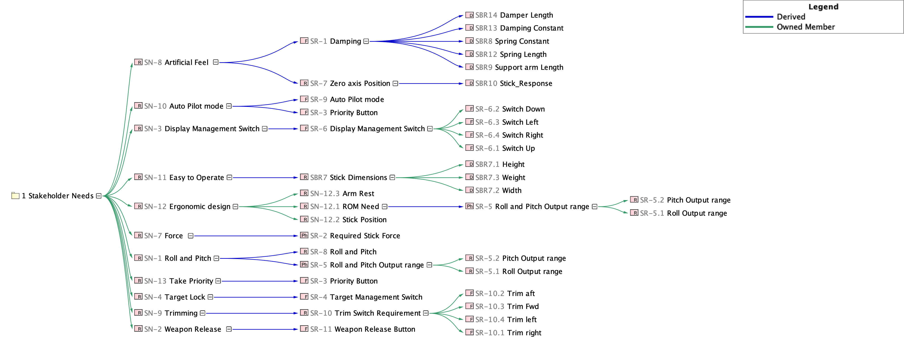
Requirements Breakdown Example
Stakeholder Needs / Req
System Requirements
Sub-System Requirements

Slide 34
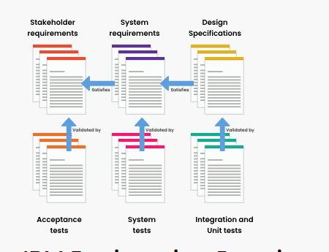
Digital Requirement Management
Collaborating all the Stakeholders on a Single Platform
End-End Traceability
Change Management
Variant Management
Quality Management and Baseline with Version Control
Scalability and Reusability

Slide 35
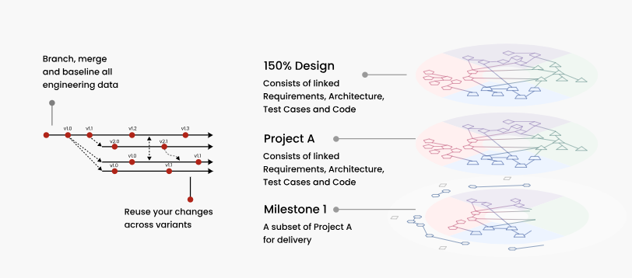
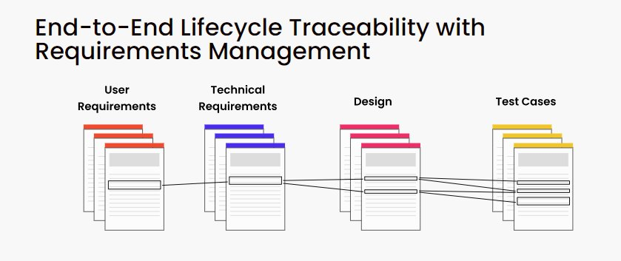
Variant Management
Reduced Costs
Better Agility
Better Efficiency
Better Traceability
Better Quality
Better Reusability

Slide 36
Data Model and Workflow

Slide 37
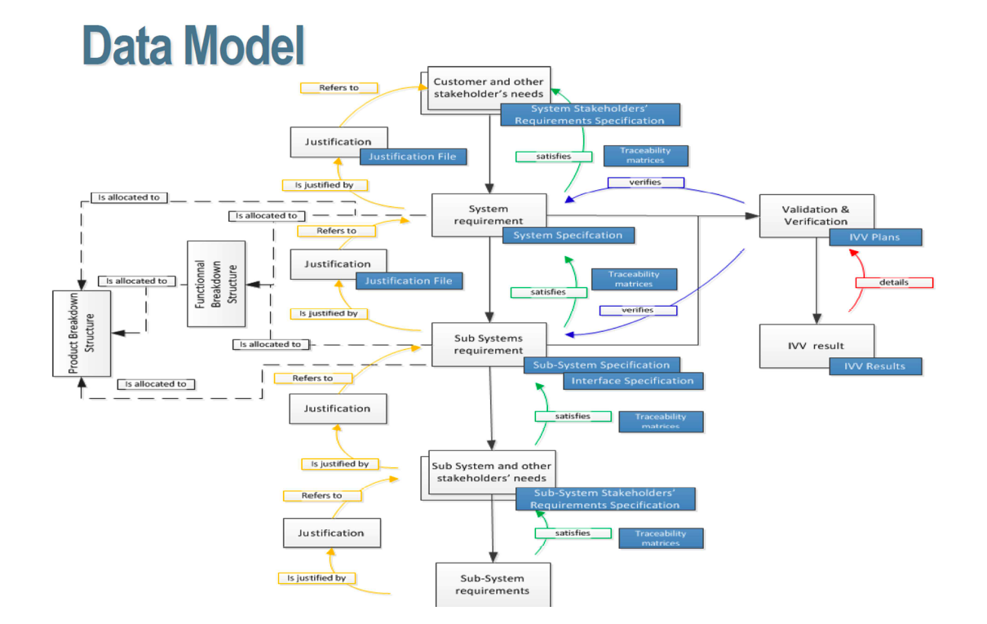
Source : Requirements and Architecture within Modelling Context
This White Paper is an AFIS collective work directed by the MBSE technical Committee (INCOSE)

Slide 38
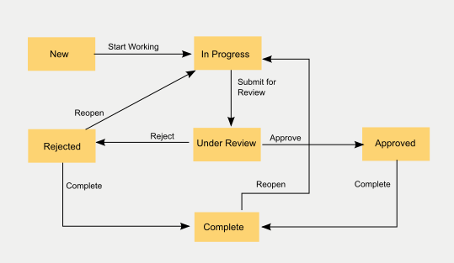
Requirements Management Workflow Example
Source : IBM

Slide 39
The End

